Slide 1

Intelligent optimization algorithm Week 05_ Introduction02

Slide 2
Outline (目录)
Optimization problem
Single objective optimization problem
Stochastic optimization algorithms
Constrained optimization algorithms
Multi-objective optimization problems
2/16

Slide 3


Multi-objective Optimization Problems
05
Multi-objective optimization problems
SINGLE-OBJECTIVE
MULTI-OBJECTIVE
4/16

Slide 4
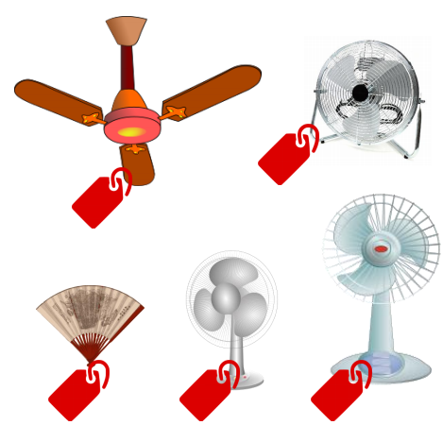

Multi-objective Optimization Problems
05
Analogy: Hot summer
Fans
4/16

Slide 5


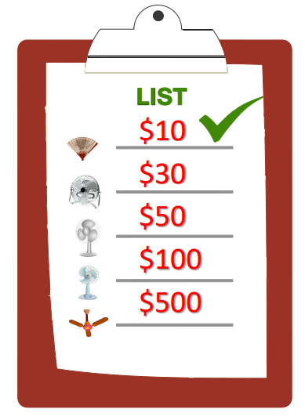
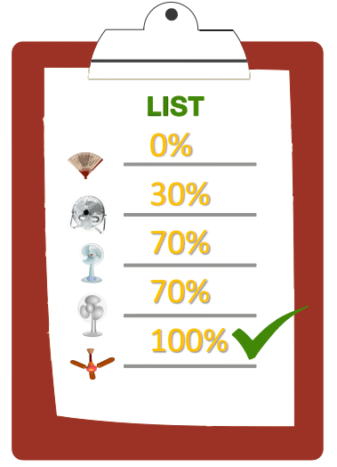
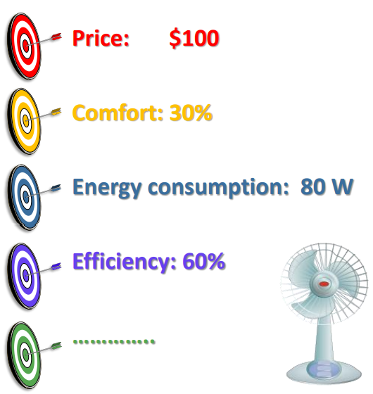
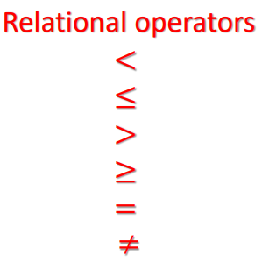
Multi-objective Optimization Problems
05
Analogy: Hot summer
MINIMIZE THE PRICE
MAXIMIZE COMFORT
4/16

Slide 6
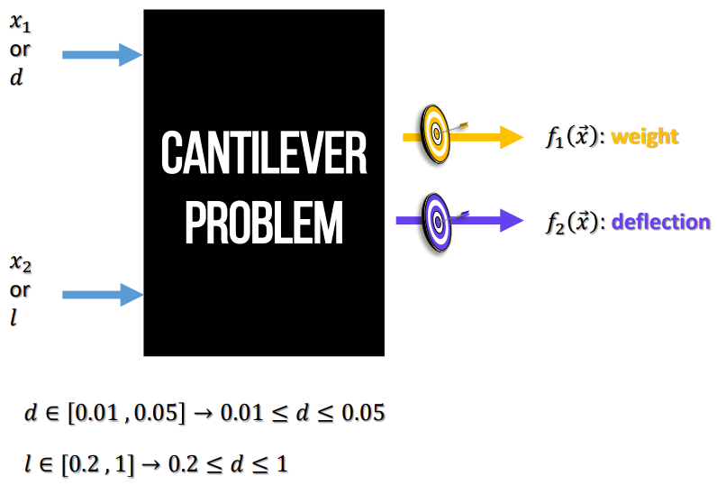
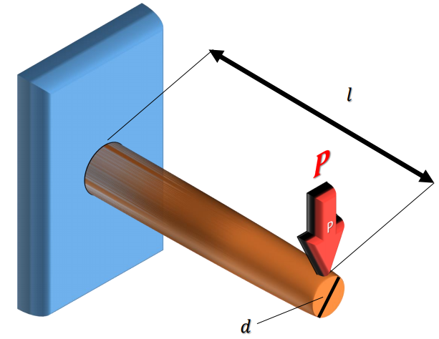
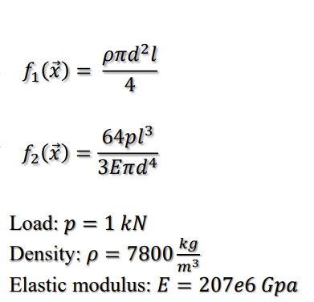
Multi-objective Optimization Problems
05
An Example of a real-world problem with multiple objectives
4/16

Slide 7
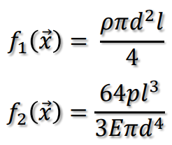
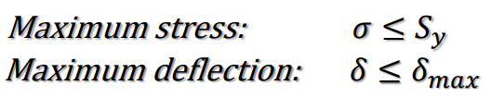
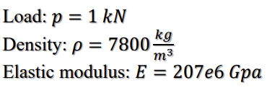
Multi-objective Optimization Problems
05
Cantilever beam design problem
𝑀𝑖𝑛𝑖𝑚𝑖𝑧𝑒:
𝑆𝑢𝑏𝑗𝑒𝑐𝑡 𝑡𝑜:
4/16

Slide 8
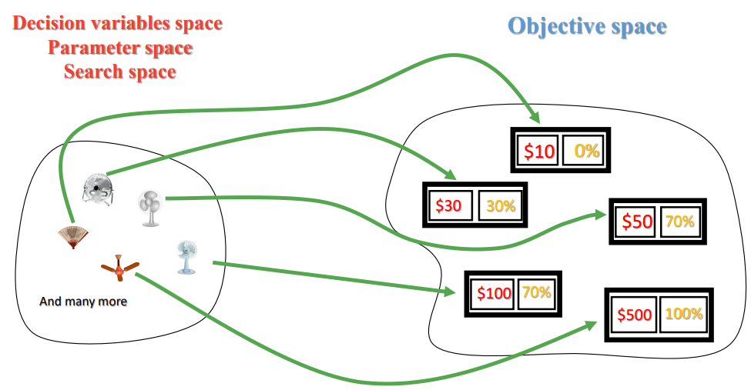
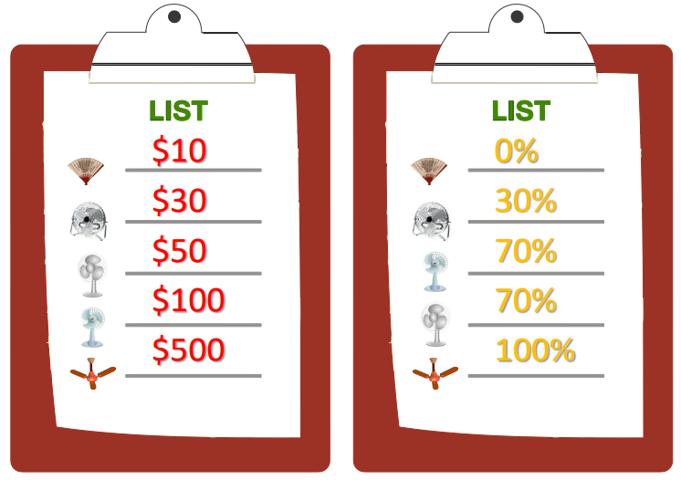
Multi-objective Optimization Problems
05
Decision variable space and objective space
ANALOGY: FINDING A FAN WITH MIN PRICE AND MAX COMFORT
4/16

Slide 9
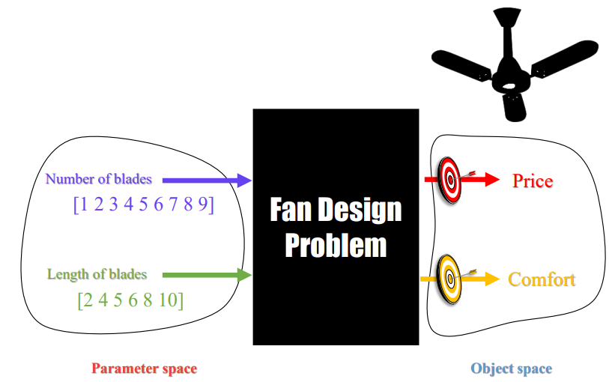
Multi-objective Optimization Problems
05
More accurate example: designing a fan instead of buying
4/16

Slide 10
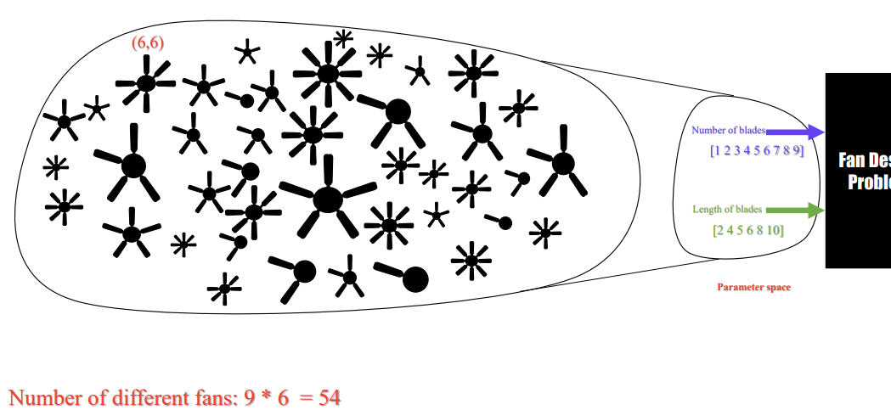
Multi-objective Optimization Problems
05
Variable spaceer
4/16

Slide 11
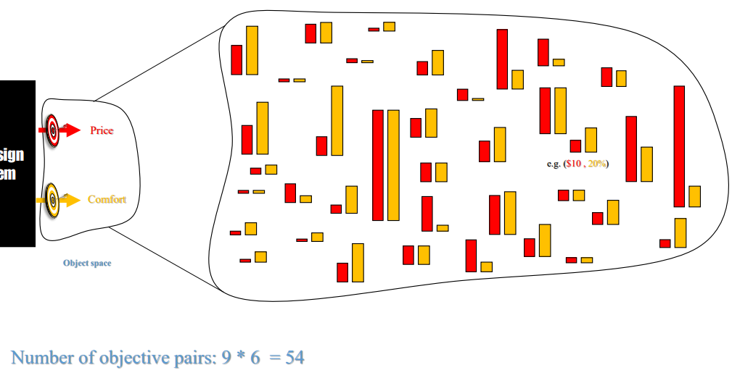
Multi-objective Optimization Problems
05
Objective space
4/16

Slide 12
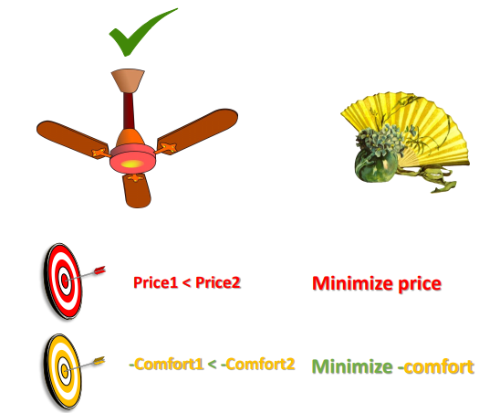
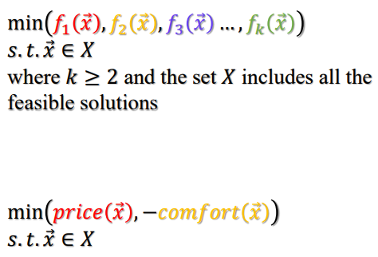
Multi-objective Optimization Problems
05
Pareto dominance:帕累托优势
Comparing solutions in multi-objective problems
4/16

Slide 13
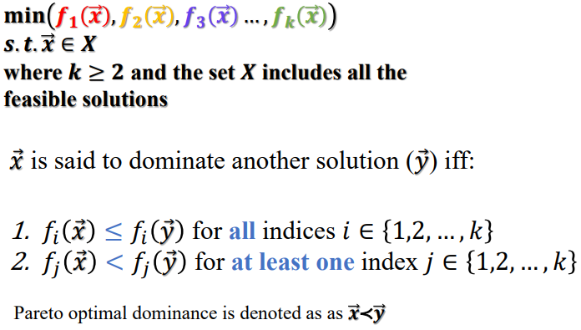
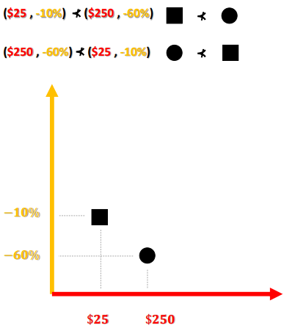
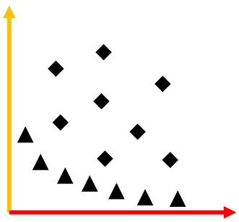
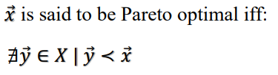
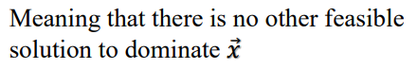
Multi-objective Optimization Problems
05
Pareto optimal dominance:帕累托优势
Pareto Optimality
NON-DOMINANT SOLUTIONS
DOMINANT SOLUTIONS
4/16

Slide 14
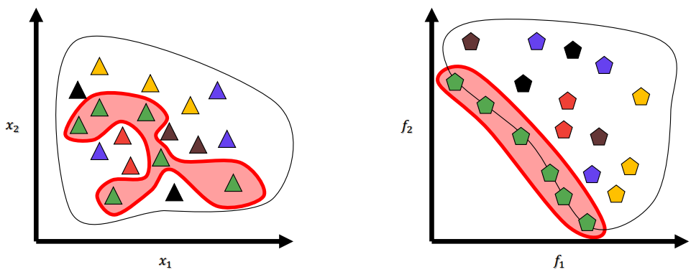
Multi-objective Optimization Problems
05
Pareto optimal solution set & Pareto optimal front
Parameter space and objective space
4/16

Slide 15
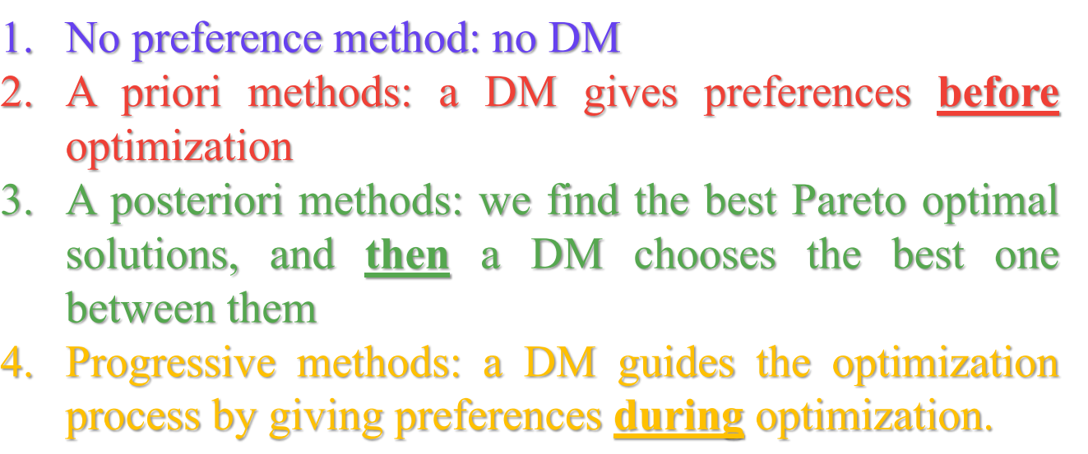
Multi-objective Optimization Problems
05
Different methods for MO
Classified based on a Decision Maker (DM):
4/16

Slide 16
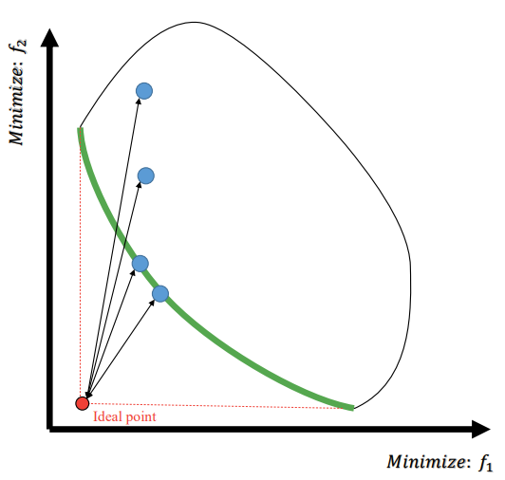
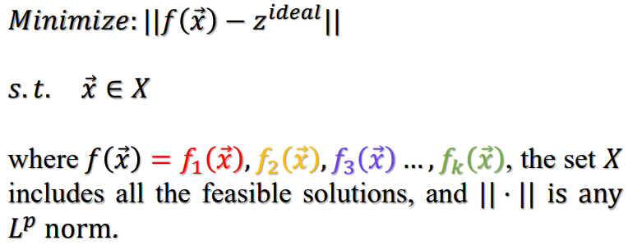
Multi-objective Optimization Problems
05
No preference method
4/16

Slide 17
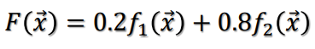
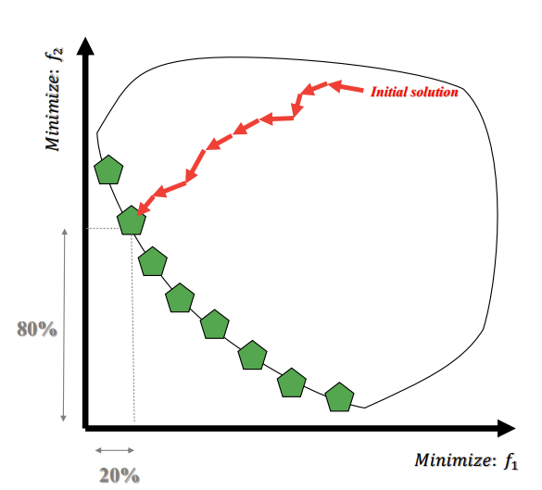
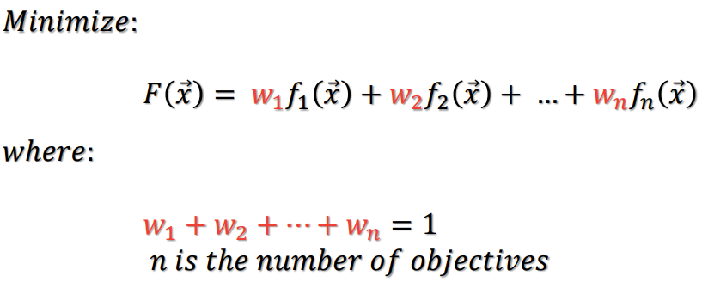
Multi-objective Optimization Problems
05
Weighted sum method
4/16

Slide 18
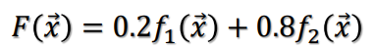
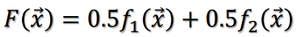
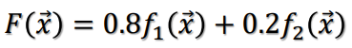
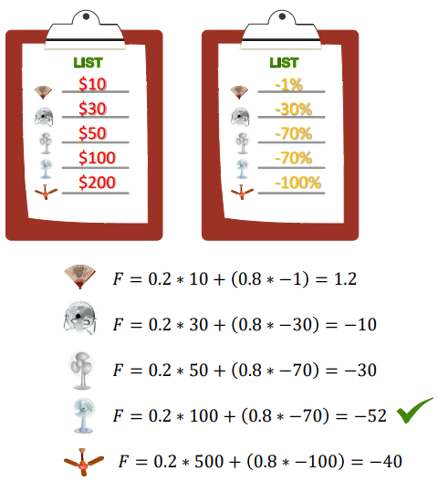
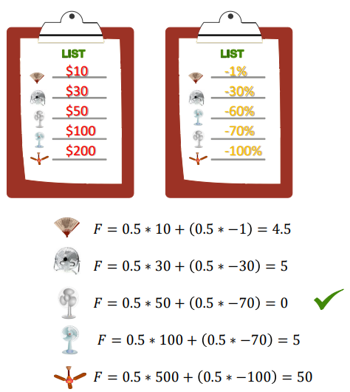
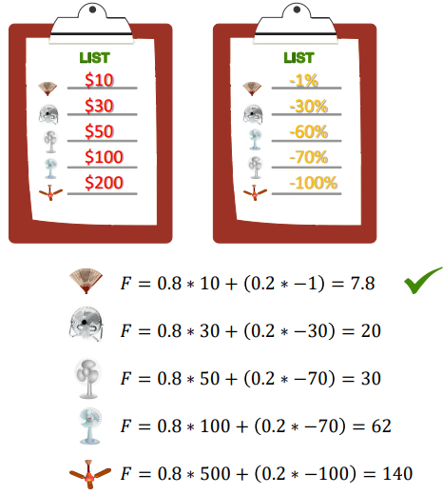
Multi-objective Optimization Problems
05
Example: Weighted sum method
4/16

Slide 19
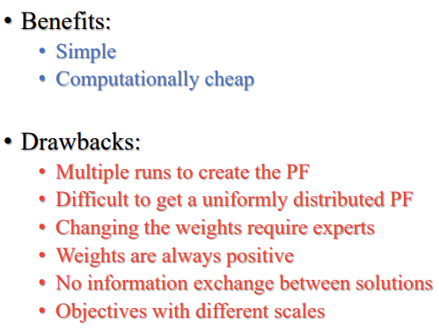
Multi-objective Optimization Problems
05
Weighted sum method
4/16

Slide 20
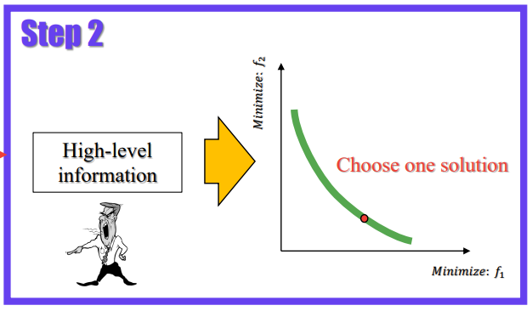
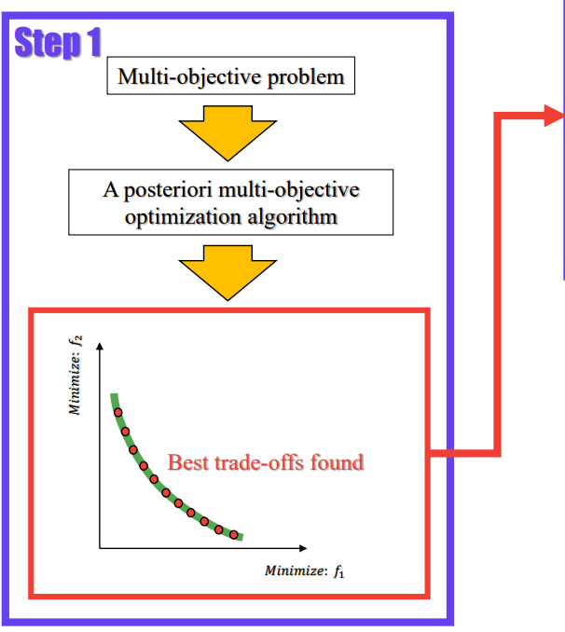
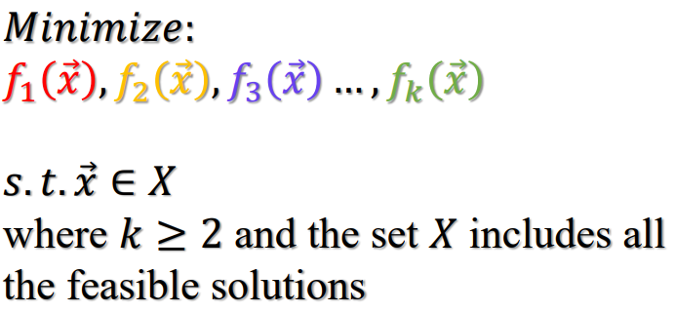
Multi-objective Optimization Problems
05
A posteriori method
4/16

Slide 21
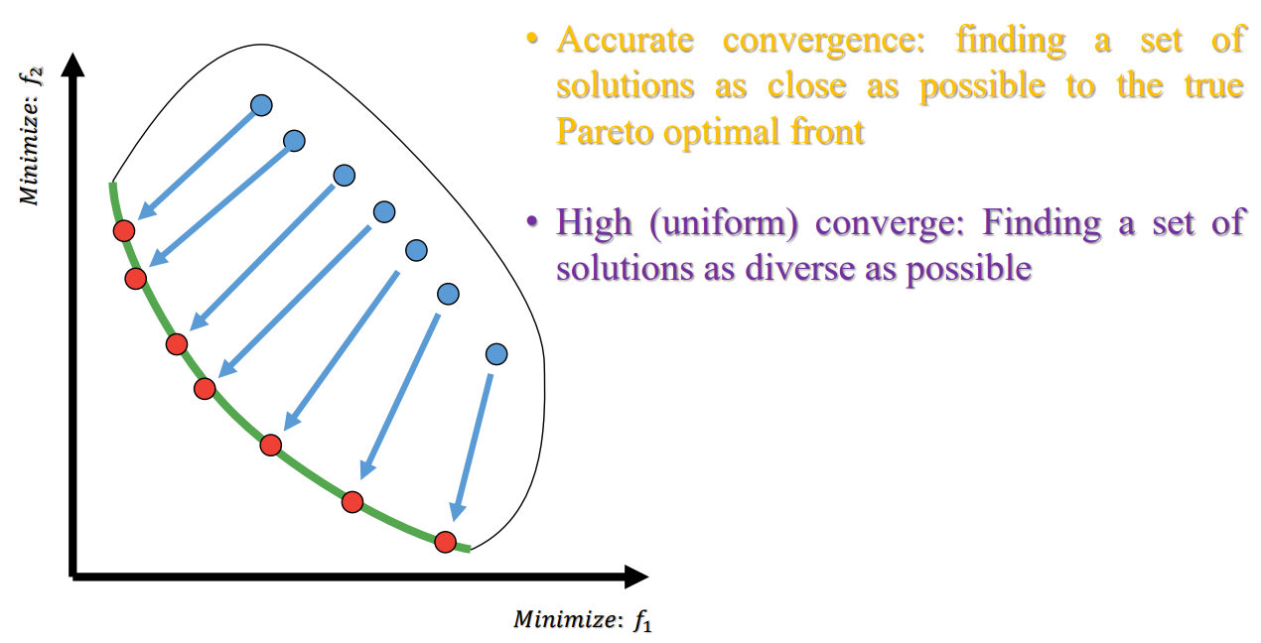
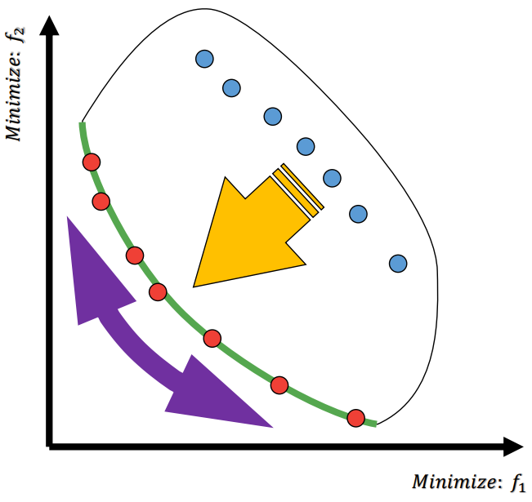
Multi-objective Optimization Problems
05
Posteriori methods using evolutionary algorithms
CONVERGENCE AND COVERAGE
4/16

Slide 22
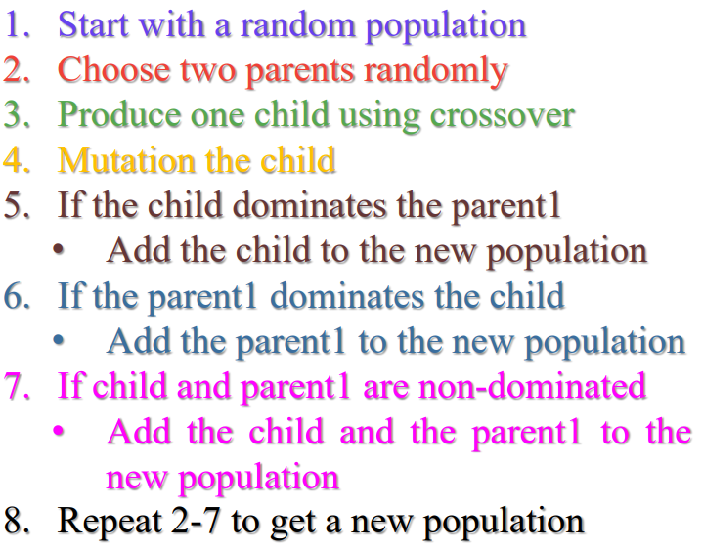
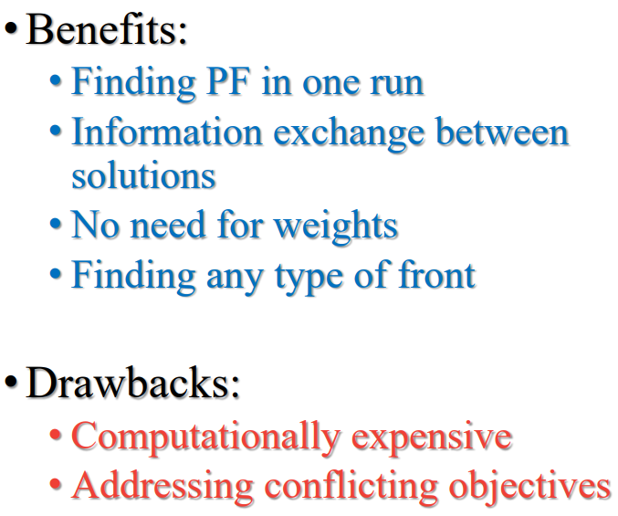
Multi-objective Optimization Problems
05
Posteriori methods
SIMPLE MULTI-OBJECTIVE EVOLUTIONARY ALGORITHM: SMOEA
4/16

Slide 23
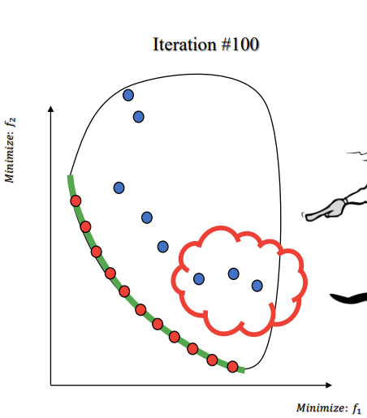
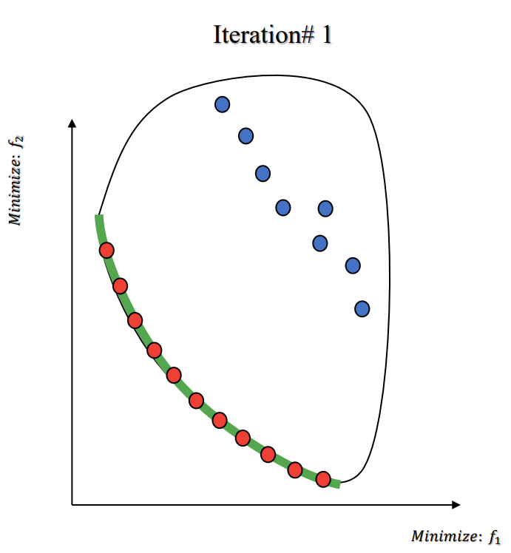
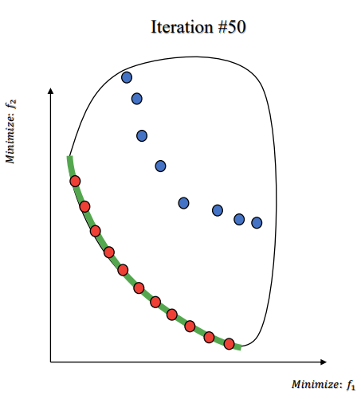
Multi-objective Optimization Problems
05
Progressive (interactive) methods
Progressive methods
I am interested in this area,
search more here
4/16

Slide 24



This program is writing for Ansys HFSS software. It possesses three parts including the basic software operations, advanced data post-process, and optimization algorithms. Maybe it will also have some GUI design and others.
This is the third part --- optimization algorithms, which mainly includes the basic data input and output funcitions and normal optimization algorithms (PSO, GA, GWO and others) . To make it easier to use these algorithms, there are examples for optimization.
Hope you will have a pleasant experience!
The program starts from 18th NOV. 2020 at City University of HK. Here we have a group of partners (Chen Yang, Ting Li, Zhiyi Zhang, and Zhili Su) with the guidance of Dr. Lu Kai, Hope we can complete this huge project. Best regards to us. If you have any questions, please email to Chen.Yang@my.cityu.edu.hk
Created on Wed Jan 20 01:30:11 2021

